Slide 1
Ansible
GBIF CESP Workshop, Madrid 2018
Dave Martin

Slide 2
Ansible - What is it ?
“Automation of software provision”
Tool for sending commands to 1 or more machines
Uses SSH / SCP
Easy to read scripts
Notes:
We have “ALA Demo” in Github as a starting poing

Slide 3
Ansible - for Living Atlases
Initial deployment
Setup of Ubuntu virtual machines
Apply upgrades
Configure a system for your needs
Setting up test environments

Slide 4
Ansible
Playbooks
Uses one or more “Role”
Roles
Example role - install MySQL
Inventories
Specifies the server

Slide 5
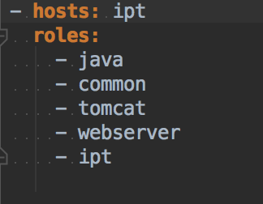
Ansible - Example playbook

Slide 6
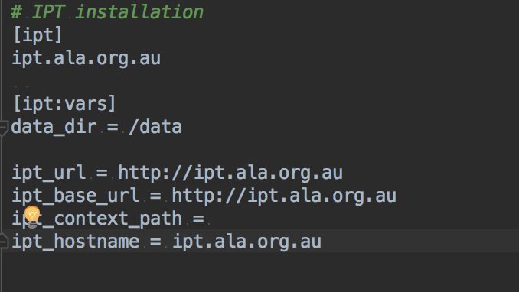
Ansible - example inventory

Slide 7
Inventories for ALA
See ala-install/ansible/inventories/vagrant
Inventories for all ALA components
Create inventories using these to start
Test deployments with vagrant

Slide 8
Tags
...are your friend
(Re) run sections of playbooks
See options:
--tags
--skip-tags

