Slide 1
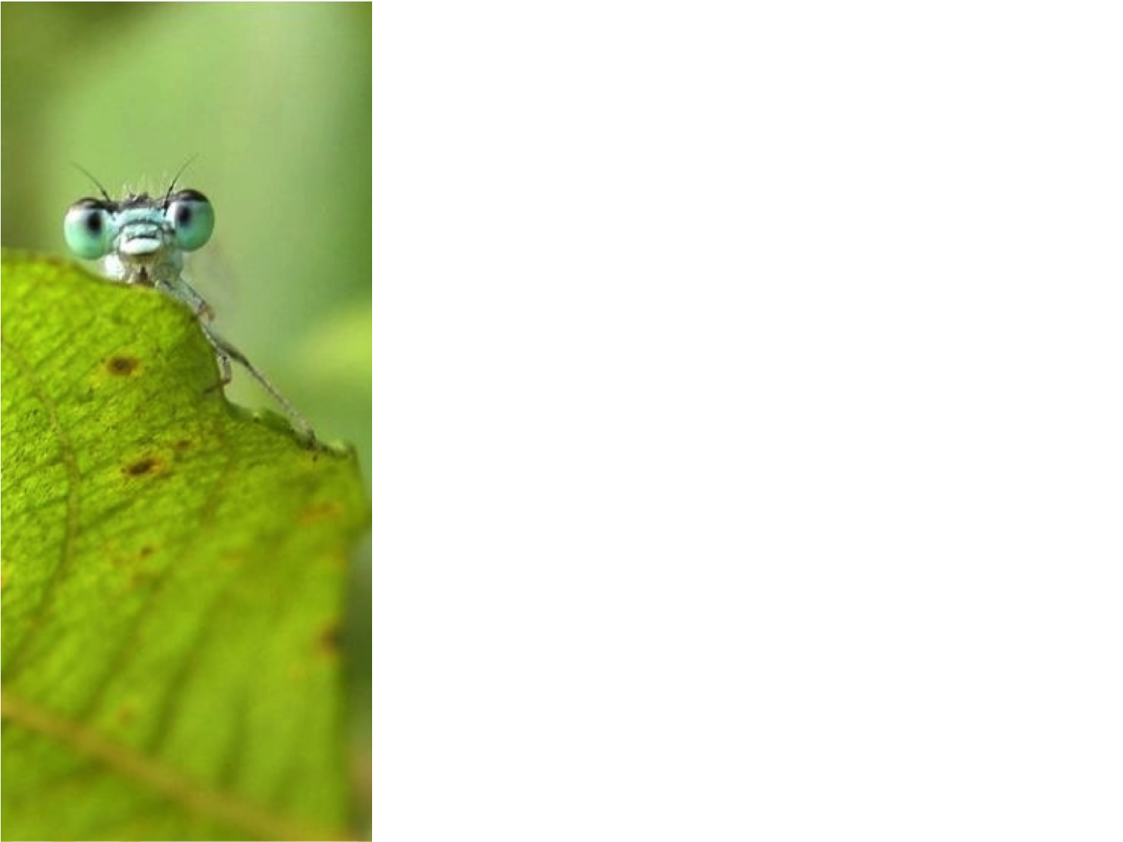
Documentation for the Living Atlases Community
International Living Atlases workshop
19-23 February 2018
Fabien Caviere
dev@gbif.fr

Slide 2
Documentation & GitHub
CoopBioPlat informations
ALA Documentation
Projects around ALA documentation
The differents parts of the ALA GitHub

Slide 3
CoopBioPlat informations
CoopBioPlat project :
GBIF Nodes of :
Argentina, Brazil,
Costa Rica, France,
Portugal, Spain,
Cooperated on national biodiversity data portals based on ALA.
Demonstrated technical cooperation and progress in that area (ALA community).
2 meetings :
Argentina : June 2015 (Buenos Aires)
Spain : October 2015 (Madrid)

Slide 4
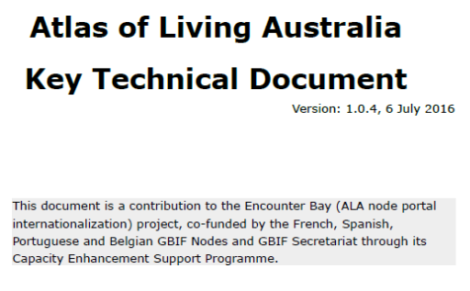
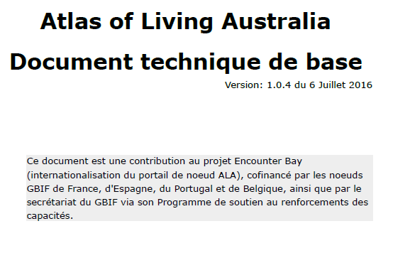
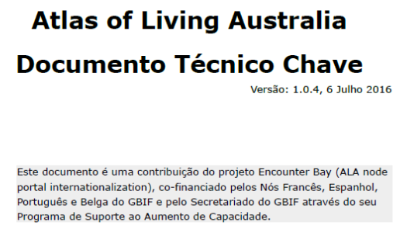
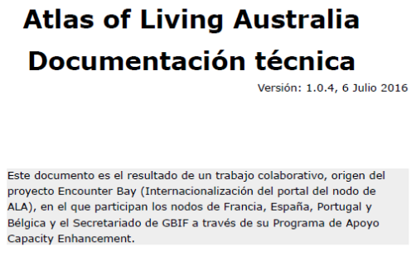
CoopBioPlat informations
Key Technical Document in multiple languages:
Available on gbif.org

Slide 5
ALA Documentation
Demonstration :

Slide 6
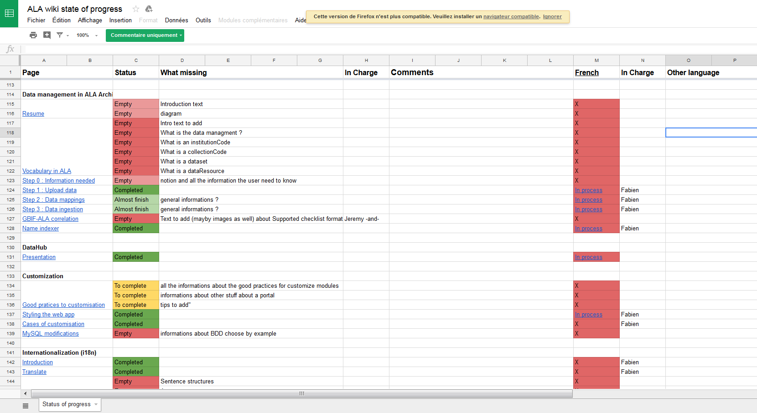
ALA Documentation
https://docs.google.com/spreadsheets/d/1e1Y9R_vUUXbO5drE11CZlZS0wTOme-CcBGLLRI1HVoo/edit#gid=1805639524

Slide 7
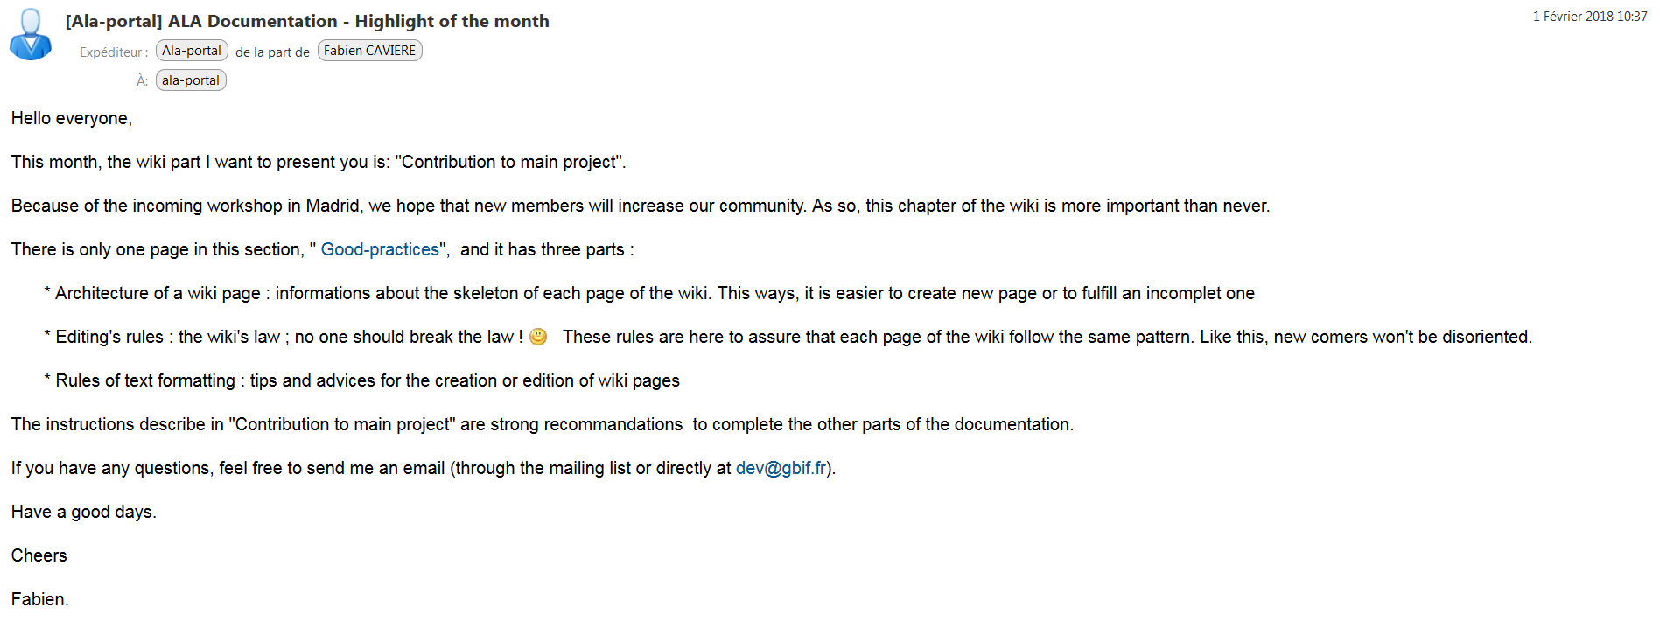
ALA Documentation

Slide 8
Projects around ALA documentation
CESP project :
July 2017 (Montréal, Canada) : Mentoring between Canadensys and GBIF France to help open the Living Atlases to French-speaking countries
TDWG presentation :
October 2017 (Ottawa, Canada) : 1-session Workshop
CESP Call 2018-2019 :
Documentation in the form of video tutorials and exercises in different languages.

Slide 9
The differents parts of ALA GitHub
ALA GitHub profile : https://github.com/AtlasOfLivingAustralia
Setup for ALA Demo (Ansible & Vagrant) : https://github.com/AtlasOfLivingAustralia/ala-install
ALA documentation : https://github.com/AtlasOfLivingAustralia/documentation/wiki
ALA wiki state of progress : https://docs.google.com/spreadsheets/d/1e1Y9R_vUUXbO5drE11CZlZS0wTOme-CcBGLLRI1HVoo/edit#gid=1805639524
Biocache-Hub : https://github.com/AtlasOfLivingAustralia/generic-hub
Collectory-Hub : ttps://github.com/AtlasOfLivingAustralia/collectory-hub

Slide 10
Documentation & GitHub
Thank you for your attention
Questions / Talk time

